Slide 1
Microservices and DevOps
Scalable Microservices
Stability Patterns
Henrik Bærbak Christensen

Slide 2
Anti --- Antipatterns
Nygaard lists 14 antipatterns
Users, blocked threads, slow response, chain reactions, etc.
So – how to combat these???
The Stability Patterns
(and the ‘Remember this’ section in each antipattern chapter, which mentions stability patterns that are not mentioned in this chapter, hmmm)

Slide 3
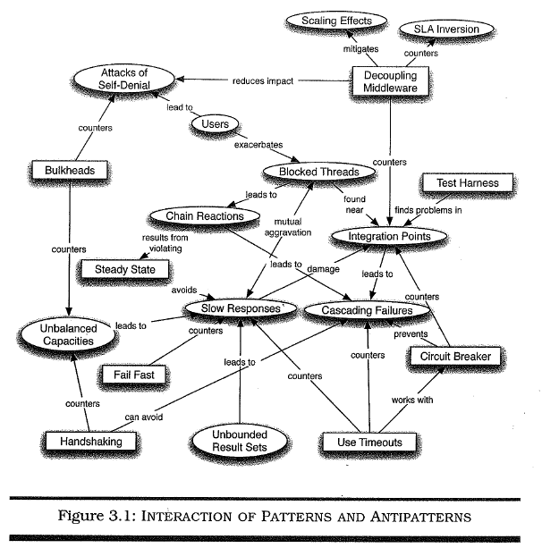
Summary
Note: Figure from first edition!
Missing in 2nd Ed, and a bit different pattern set
But – nevertheless…

Slide 4
Is All This Clutter Necessary?
As stated by Nygard:
… handling all the possible timeouts creates undue complexity in your code. It certainly adds complexity.
… Your users may not thank you for it, because nobody notices when a system doesn’t go down, but you will sleep better at night.

Slide 5
Timeouts
Timeouts: Guard any call to remote units with timeout to avoid waiting forever on an answer that never arrives
Well placed time-outs provide fault isolation: your code does not break due to a failure in another subsystem.
Beware of vender supplied APIs, sometimes they have forgotten to add time out parameters ☹
Or it is in the API, but not implemented ☹ ☹ ☹

Slide 6
Timeouts
Timeouts: Guard any call to remote units with timeout to avoid waiting forever on an answer that never arrives
Apply to Integration Points, Blocked Threads, and Slow Reponses
Consider delayed retries
Network issues take time to go away – do not retry again immediately
See ‘Retry’ pattern (that I introduce) later…

Slide 7
Timeouts on Locks
Java supports running multiple threads
To avoid ‘weird stuff’ you need to guard ‘critical regions’
i.e. the method that two or more threads may call at the same time
Classic Java
Synchronized methods cannot time out!
Modern Java
ReentrantLock myLock;
Acquire not by ‘myLock.lock()’ but…
By ‘myLock.tryLock(3, TimeUnit.SECONDS)’

Slide 8
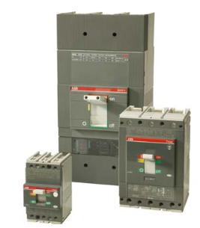
Circuit Breaker
The idea of a fuse: Burn before your house does!
Circuit breaker: Da: Maksimalafbryder
… en automatisk afbryder, som bruges til udkobling af overstrømme.
Består af bryderdel og relædel. Relædelens funktion er at måle strømmen og i tilfælde af en overstrøm udkoble af- bryderen
HFI relæ

Slide 9
Circuit Breaker
Circuit Breaker: Wrap dangerous operations with a component that can circumvent calls when the system is not healthy. Differs from retries, in that circuit breakers exist to prevent operations rather than to re-execute them.

Slide 10
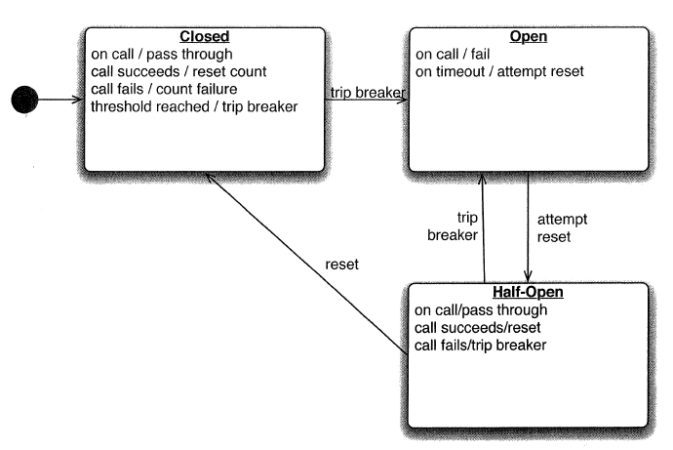
Circuit Breaker
Closed state:
Execute operation as normal
If operation fails (timeout) then
Note it (increment failure count)
If failure count > threshold then Open
Open state:
Fail fast, avoid the wait for timeout
After a set time, switch to Half-open
Half-open state:
Execute operation again
if fail then goto Open state immediately
if success then goto Closed state
Exercise: Why the need of the half-open state?

Slide 11
Circuit Breaker
Is a way to make ”graceful degradation”
Degrade functionality when under strain
Avoid DogPile, as it gives producer service time to recover
Important to involve stakeholders
”What to do if in the open state?”
What to do if we cannot verify credit card?
Remember
Use together with timeouts
Expose, track and report state changes
Log any ”popped fuses”!

Slide 12

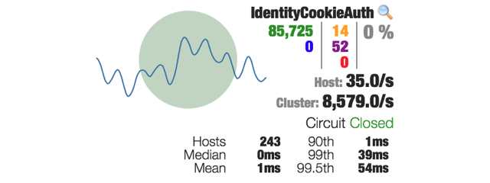
NetFlix
NetFlix is a large micro service system, based upon circuit breakers.
Open sourced their circuit breaker implementation w. dashboard

Slide 13
Resilience4J
… is
A lightweight, easy-to-use fault tolerance library inspired by Hystrix, but designed for Java 8 and functional programming.
You can pick and choose just the piece you want
CircuitBreaker: Nygard’s pattern in it’s frequency form
Bulkhead: Limit number of concurrent executions
RateLimiter: Limit rate of requests (or queue them)
Retry: Retry call N times with M mS delay between
TimeLimiter: Nygard’s Fail Fast pattern
Cache: You guessed it ☺

Slide 14
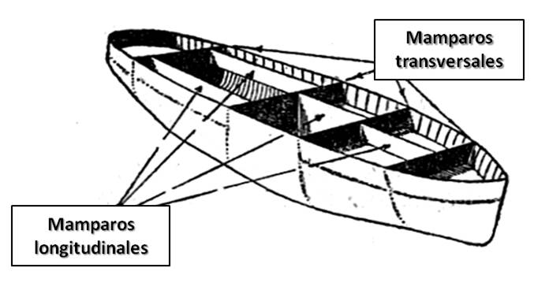
Bulkheads
Da: Skot
Partitions that can be closed preventing water from moving from one section to the next
Damage containment
Bulkheads: Partitioning a system so failures in one part does not lead to system failure
Simplest (most common) form: Redundancy
Have two or more servers handling the load

Slide 15
Bulkheads
Mission-critical form:
Pool of servers/services reserved for critical use while the rest are available for non-critical use
Example
Servers dedicated to airline check-in (critical)
Others serve flight status checking (non-critical)
Liability (see next slide)
You now have two disjoint resource pools that are subject to unbalanced capacities
I.e. you need more reserved capacity

Slide 16
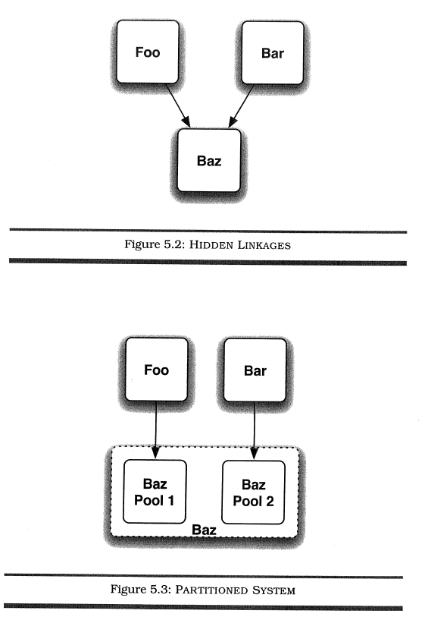
Bulkheads

Slide 17
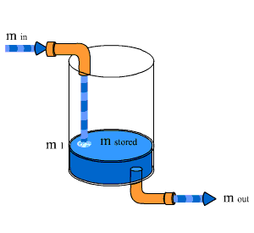
Steady State
Steady state: For every mechanism that accumulate resources, some other mechanism must recycle that resource.
If not, accumulated resources outgrow capacity
Log files, DB rows, caching, …
If capacity is exceeded - bad things happen

Slide 18
Examples
MongoDB
Allocated disk in max 2GB chunks
If it cannot it simply stops processing write requests, only processing read requests
Will not reenable write requests until after restart
(and data purge and compacting is a write request ☺)
Docker container logs are written to storage
So if you never look at them, they just grow

Slide 19
Steady State
Another potential definition
Steady state: A system should be able to run indefinitely without intervention
Otherwise, you get used to fiddling
Which leads to what Nygard terms ”oh-no-second”
The split second when you realize you have hit the wrong key, shut down the wrong server, deleted the wrong DB table…
My personal fear was ”db.GFKRE003.drop()”
6TB of data from 4 years of data collection

Slide 20
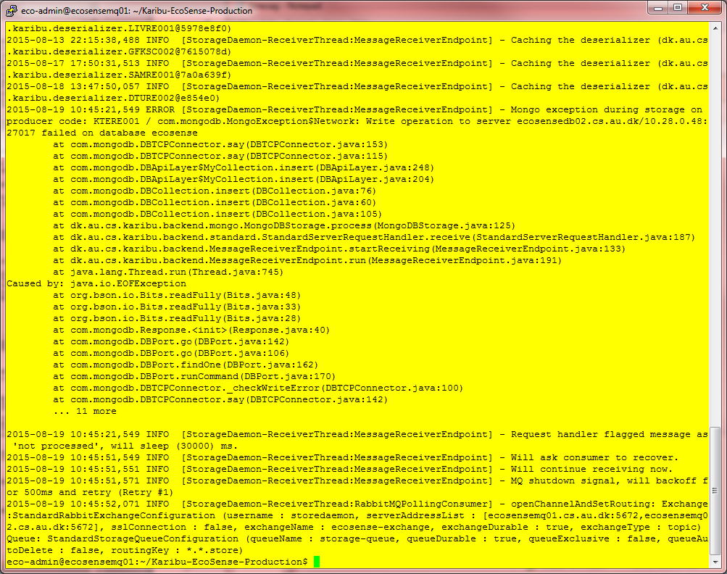
My own Fiddling trick
A linux shell looks like … a linux shell
Make staging machines and production machines look different!
Production machine always have awful color choices!
I do not mistake one for the other!
I hope…

Slide 21
Steady State
Data purging
Remove old data from the DB
Can be pretty tricky in RDB
Referential integrity, orphaned rows, …
And perhaps even more so in NoSQL
Log files
If not purged, you run out of disk space
Java.io.IOException!
Dump a stacktrace in the face of the user ☺
Review the Log4J RollingFileAppender for non Docker use
For Docker, you write to StdOut which is stored ☹
Rewire to a logging system like ELK or Humio instead
Which then run out of disk space ☺

Slide 22
Fail Fast
Fail fast: Check resource availability at the start of a transaction, and fail immediately in case any is not available.
If not, you waste CPU and human time doing stuff that will eventually have to be redone or undone
Cook’s: mise en place
Find all ingredients before starting
Or the fish will burn while to try to find the chili paste…

Slide 23
Fail Fast
Part of fail fast is also to validate human entered values as best possible before proceeding
Typically values entered in web form or similar
Avoid connecting the DB and do a query only to find that one of the query parameters were null…
Fail Fast is a way to combat slow response
Example:
CPF system will fail immediately if a key is not found in file.

Slide 24
Let it Crash
Let it Crash: Create system-level stability, by sacrificing service-level(*) stability. The cleanest state your program has, is right after startup.
Nygard writes ‘component-level’, but guess that is synonym with our ‘services’.
Require
Limited granularity: isolate the crash to the service
Avoid cascading failures
Fast replacement: Only ‘let it crash’ if restarts are quick
Supervision: Don’t do local restarts, monitor on higher level
Reintegration: Consider how ‘back to work’ is orchestrated
Inspired by the Erlang programming language

Slide 25
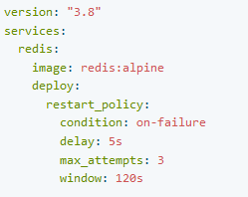
Let it Crash
We will return to HEALTHCHECK in Dockerfiles and compose-files.
Allows
Granularity is the container
Restart by the swarm (restart time is within the ~seconds)
Simple supervision and reintegration is built-in in the swarm’s stack
Restart-policy

Slide 26
Handshaking
Handshaking: Allows a client to assess whether a server has the capacity to answer a request, essentially providing the server the ability to tell the client to ”back off”
Compare
Ping-echo and Heartbeat tactics
Actually not implemented in most modern protocols, like HTTP, RMI, etc.
You will probably have to implement it yourself
Watch out for doubling the traffic: ‘can I do (1), then I do (2)’
Any HTTP call is expensive…

Slide 27
Test Harness
Test Harness: A substitute for the remote end of an integration point that produce out-of-spec failures
Like
Refuse connection, accept and then die, packet loss
Slow responses, garbage responses, protocol errors
Send one byte every 30 seconds (DOS attack), send Megabyte long replies instead of Kilobyte long replies
Send HTML instead of XML, refuse all authentication credentials, …

Slide 28
Test Harness
Da: Seletøj
Integrations test: Testing that the parts are working together to identify integration failures
Obviously closely related to integration points and the large set of stability antipatterns
Nygard: No – it is not strong enough
Integration tests test within-spec failure modes…
Operations excel in out-of-spec failure modes !!!
You do not get an error code from the remote server, it simply does not reply, or provide slow response

Slide 29
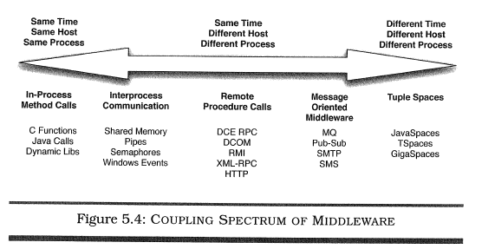
Decoupling Middleware
Middleware decisions effect the implementation cost of systems significantly
Learn many architectural styles to ensure you pick the right one

Slide 30
Shed Load
The world can always create more load than you can handle…
There is no difference between ‘really, really slow’ and ‘down’.
Shed load: Refuse new requests, if load gets too high.
Similar to ‘fail fast’ but you do not fail on service-level but on request-level
Not ‘time out exception’ but ‘503 service unavailable’
Guard calls to shed-loading services with circuit breakers or timeouts or …
Meaning of ‘Too high’?
Monitor own SLA to determine the tripping point
Shed = skille sig af med

Slide 31
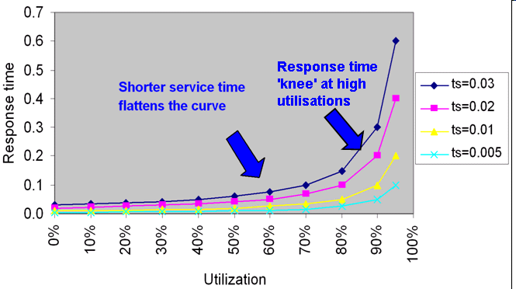
Shed Load
Back in the Queue Theory stuff…
Systems with ‘randomly timed requests’ will follow this distribution as the workload increase – response times increase exponentially ☹
Shed load when you hit the upper parts of the ‘knee’

Slide 32
Create Back Pressure
Every performance problem starts with a queue backing up somewhere…
Little’s law: L = lambda x R
L = number of requests in queue (Think Føtex kasse queue)
R = response time of request (Think ‘time until I leave’)
R = W + S, wait time + service time (in line + getting served)
lambda = arrival rate (arrival per sec, of custom.)
So
lambda is constant (influx of requests from the world)
If response time gets longer… (S large (dankortterminal i stykker)’)
… then more requests in queue
… and then queue eats all memory => crash

Slide 33
Create Back Pressure
So
… we do not want unbounded queues!
Bounded queue, what to do with ‘out of space’?
Pretend to accept new item, but actually drop it
Accept new item, drop something else
Refuse the item ( = shed load)
Block request (producer) until there is room in queue
Dropping options
In many real-time systems, only latest reading is interesting
Aircraft flight control – who gives a damn about that angle the rudder was in 30 seconds ago – more interesting what is now

Slide 34
Create Back Pressure
Block producer option
Introduces ‘flow control’, applying ‘back pressure’ upstream
(probably) propagates all the way back to the client, who will be throttled down until queue releases…
Create Back Pressure: Use finite queues and block producers if queue overflows, to slow down instead of crashing [Own definition]
Alternative to ‘shed load’
May lead to ‘blocked threads’ obviously
Are we crashed or just extremely slow?
Only use ‘within system boundaries’
Use ‘shed load’ across system boundaries instead, like open internet
Notes:
Blocking producer means putting in queue upstream, which is a finite resource. Thus in situation with potential infinite load (open internet) it does match, and you are more likely to ‘burn down everything’.

Slide 35
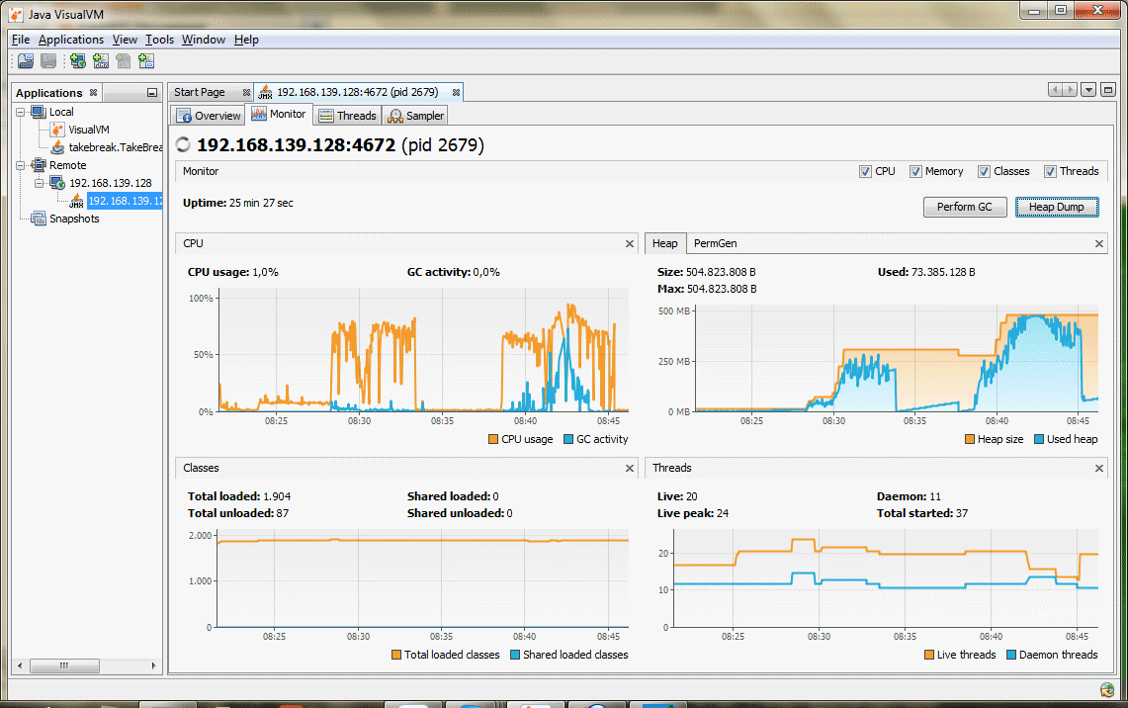
Ex
My Lyon airport load test
MongoDB was slow, so node memory exhausted
Solution
I set the ‘prefetch’ to 1!
Now Java connector does not fetch next until MongoDB has stored it (acknowledge message)
Thus, the RabbitMQ itself acts as Queue, rather than the consuming node’s heap acting as queue!
Thus applying back pressure upstream until I hit a service that can actually handle the pressure…

Slide 36
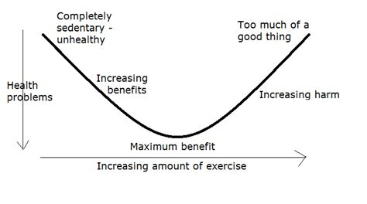
Governor
Steam engines: They can run so fast, they will break!
Engineering device: Put a speed limit on: the ‘governor’
Govenor: Stateful and time-aware control plane logic that prevents a system from exceeding its safe limits. Actions within safe limit should be fast, outside increasing resistance must be applied
Shutting down instances is unsafe, deleting data is unsafe …
Antidote for the ‘force multiplier’ antipattern…
Safe limits is kind of ‘U-shaped curve’
Slow actions down if moving outside the buttom of the U curve…

Slide 37
Bounded Result Sets
Nygard does not mention a pattern to combat unbounded result sets
Should be reasonably obvious…
Bounded Result Sets: Return large results sets in chunks that can be iterated. (Pagination)
Not ”get bible”, but ”get bible, page 7564, page 7565, …”
Mongo: use find().skip(n*page).limit(n)

Slide 38
Retry
Perhaps too obvious, but…
Why does Nygard not mention ‘Retry’ as a pattern?
Only indirectly in ‘time outs’ pattern
Retry: If a request fail/time out, then retry the request some time later a number of times before giving up
Only do it, if it makes sense! And who does the retry?
Fixed retry intervals
Beware: May lead to dogpiles! We herd the calls together in lumps
Gaussian retry intervals (?)
‘Exponential backoff’
Retry after 1s, 2s, 4s, 8s, 16s, and then give up.

Slide 39
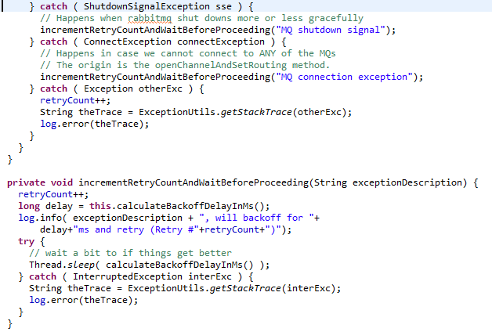
Use Timeouts
Example
Exponential Back-off
Wait 1 second, then 2, then 4, then 8, then 16…

Slide 40
Who does Retry?
Exercise:
PlayerServant delegate to CaveStorage delegate to MongoDB
MongoDB’s primary fails and throws exception…
We will talk about passive replication technique shortly
Exception caught in CaveStorage but
Handle it locally in CaveStorage and do a retry?
Rethrow as ‘ElectionException’ and handle in PlayerServant?
Pro and Con of each solution?

Slide 41
Experience F2020
In ‘design for failure’ in F2020 I herded students into trying to find graceful degradations
Like retries
General impression
Seemed that the code became cumbersome and the results for the users not quite intuitive
“dig n My new room”
“Could not dig your room, will retry later” ???
So this year
Fail fast and report it
“Could not dig your room, you have to try again later”

Slide 42
Summary
Phew…
Plus
Shed load
Back pressure
Govenor
Bounded Result sets
Retry

